Slide 1
report launch may 11, 2016 Yangon, myanmar
Dr. Sergiy Zorya
Agriculture Programme Coordinator in Southeast Asia
The World Bank

Slide 3
This report is a continuation of the successful long-term partnership between the lift and the world bank

Slide 4
The Multi-Institutional Project
The LIFT and the World Bank initiated the project and provided the overall coordination, inc. the preparation of the final report
Myanmar Marketing Research Development (MMRD) designed the survey and collected the primary data
The Food and Agriculture Organization (FAO) and the International Rice Research Institute (IRRI) helped with design of the survey and its quality control
The AgriFood Consulting International carried out analysis of the primary data

Slide 5
1. new primary data and the look beyond the averages

Slide 6
The Survey
Total sample is 1,728 farm households
Ayeyarwady (484 HHs), Bago (380), and Sagaing (501) Regions, and Shan (363) State
Two rounds of the survey: monsoon (Nov-Dec 2013) and dry season (Apr-June 2014)
Agro-ecological zones:
Ayeyarwady [salt water, brackish water, fresh water]
Bago [west alluvial, east alluvial, east/west flooded land]
Sagaing [irrigated, dry land, river area]
Shan [southern interior, northern interior, border area]

Slide 7
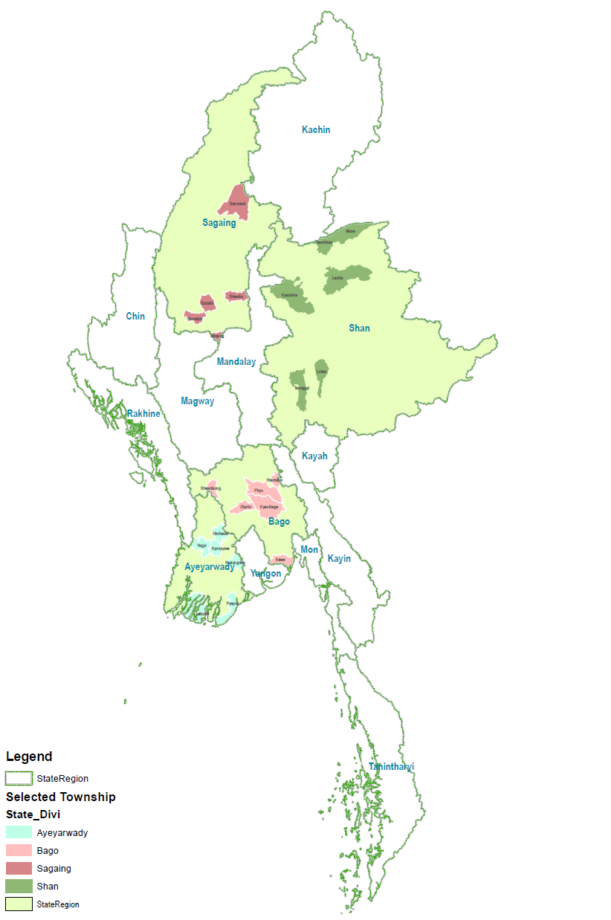
The Survey Townships
24 Townships
96 Village Tracts

Slide 8
Farm Groupings
Male-headed households
Female-headed households

Slide 9
2. Comprehensive survey

Slide 10
The Survey Sections
Demography
Education
Assets and access to services
Farm land (size, land use rights, taxes, rents, land use)
Production of rice
Consumption of rice
Production of other crops (maize, groundnuts, sesame, sunflower, beans and pulses)
Household module
Production module

Slide 11
3. Detailed and consistent crop budgets

Slide 14
In Myanmar, Pulses and Oilseeds are more profitable and less costly to produce than paddy
 | Net margin, $/ha | Labor productivity, $/day | Production costs, $/ha | Labor use, days/ha
Monsoon paddy | 114 | 4.75 | 510 | 103
Dry season paddy | 246 | 9.20 | 626 | 63
Black gram | 267 | 9.29 | 237 | 45
Green gram | 581 | 15.92 | 355 | 51
Chickpeas | 141 | 6.85 | 266 | 42
Groundnuts | 324 | 8.32 | 421 | 65
Sesame | 202 | 8.54 | 217 | 44
Sunflower seeds | 377 | 15.68 | 121 | 30

Slide 15
4. Consistent and Interesting International Comparisons

Slide 16
The Survey Focus
This survey is not a farm census and is not country representative
The survey covers production level, neither supply and value chains nor institutional factors
It focuses on the main village tracts:
They are likely to be better-off performers
They are most economic active, centers for government services and trade, and usually long established in areas with better soils and production environment
More remote village tracts are likely to generate lower incomes and use more traditional technologies
The focus on “main” villages allows better international comparisons

Slide 17
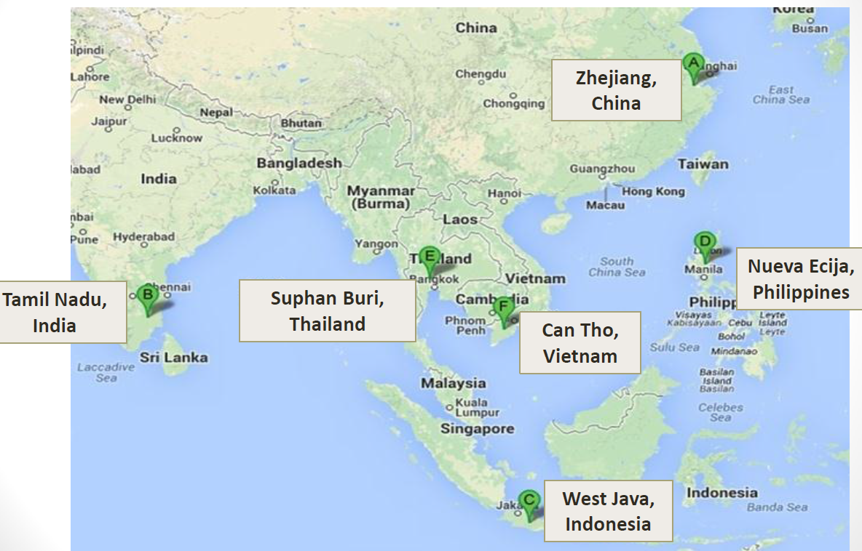
International Study of the Phil Rice and IRRI (2014/15)

Slide 18
Paddy Yields in Myanmar are very low
 | Average (USDA) 2013/14-2014/15 | Better Farms (Surveys)
Thailand | 2.8 | 5.7
China | 6.7 | 6.6
Vietnam | 5.8 | 6.8
Philippines | 3.9 | 6.3
India | 3.6 | 4.7
Myanmar | 2.7 | 2.7
Source: 2013/14 Myanmar agricultural survey for Myanmar data and Bordey et al. 2014 and 2015 for other countries.

Slide 19
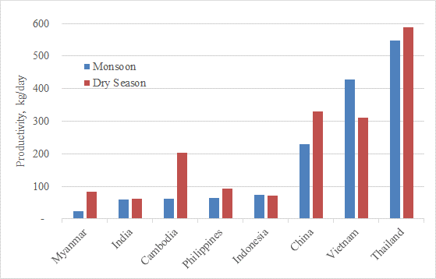
labor productivity is also low
Low Yields and High Labor Use Keep Myanmar’s Labor Productivity Low
Note: Data for Myanmar are for Ayeyarwady. Data for other countries refer only to one key rice-growing area.
Source: 2013/14 Myanmar agricultural survey for Myanmar data, World Bank 2015a for Cambodia, and Bordey et al. 2014 and 2015 for all other countries.

Slide 20
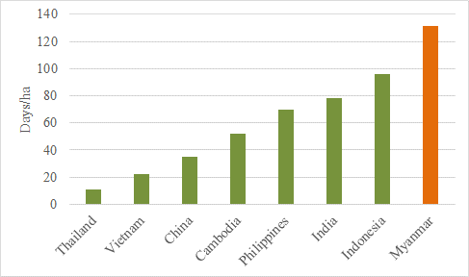
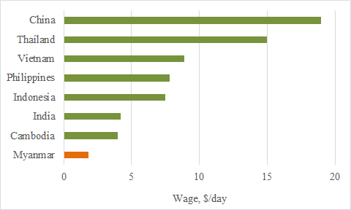
paddy production in Myanmar is very labor intensive
130 days is required for monsoon paddy production in Ayeyarwaddy
Low wages in Myanmar contribute to the high labor intensity in agriculture

Slide 21
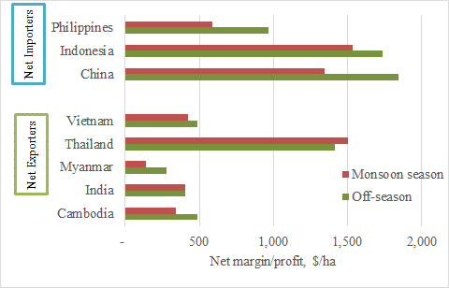
Low Profits of paddy producers in Myanmar
* Thailand profits returned to “normal” for exporters after the end of the rice pledge program in 2014

Slide 22
5. Policy relevance

Slide 23
The gap with other counties is large so right investments in agriculture will bring the high rates of return
Low productivity and profitability are the result of the undersupply of public goods [seeds, research and extension, input quality controls, etc.]
Irrigation needs attention as it does not bring high rates of return
Public programs need to go beyond paddy
Farmers need to have a freedom of production decisions and enabling public programs, including the neutral farmland classification

Slide 24
Next analytical work
Review of Agricultural Policy and Public Expenditures in 2016/17
Repeat the similar survey 2017/18 to study dynamic changes, understand farm household economics, and link production with value chains

Slide 25
Primary data is accessible online
You can download the full report and data phases at www.lift-fund.org/myanmar-analysis-farm-production-economics
Find blog post at www.lift-fund.org/blog/news-blog/unleashing-myanmar’s-agricultural-potential

Slide 26
Thank you!

